Slide 1
A Major Lifestyle A Follow up to The True Meaning behind “Decision Day”
Nikita Jones
Anusha Rama
Edward Gates, Jr.
Danica Rios
Mason Waters

Slide 2
Agenda
Project Purpose
Problem Analyzed/Visualized
Technologies Used/Explored
Machine Learning
Visualizations

Slide 3
Project Purpose
To analyze the living expense data within 5 regions to identify trends in the historic data that corelate to Mid-Career salary and its relationship to the region

Slide 4
Problem Analyzed/Visualized
Type of Problem: Multi-label classification problem.
With machine learning, this project seeks to predict the region in which a user lives by examining the historical data of residents within a select region and the average living expenses in the selected region.

Slide 5
Technologies Used/Explored
Python
Pandas
Sklearn
Tensorflow
BeautifulSoup
Browser
Deepcopy
Numpy
Tableau
Amazon AWS
HTML/CSS Bootstrap

Slide 6
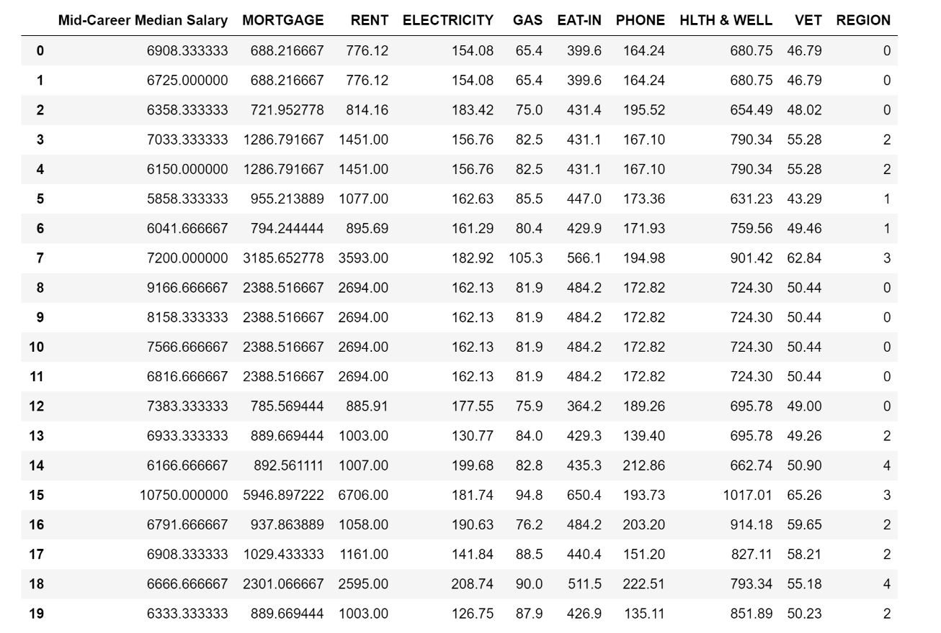
Machine Learning
Training
80%
Testing
20%
Predict
72% Accuracy

Slide 7

Visualizations

Slide 8
?
Any questions?
?
?

